Slide 1
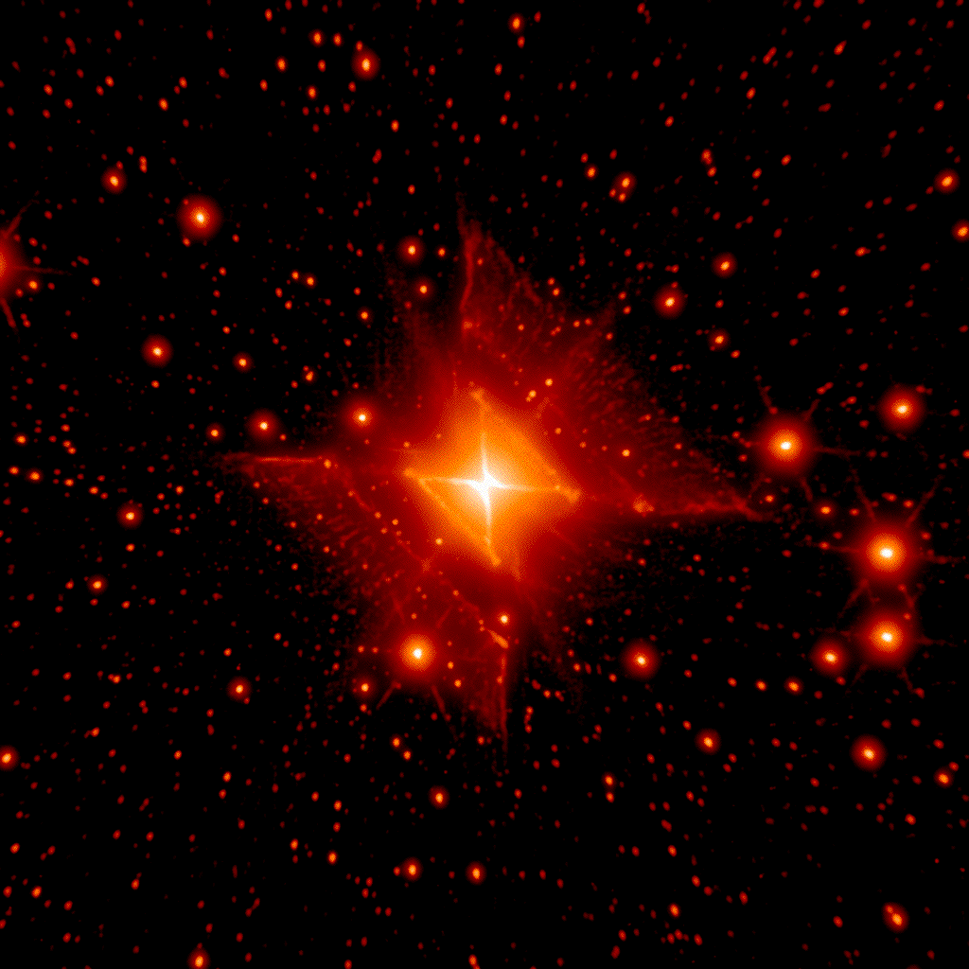
The quest for coherence:
astrophysical imaging from interferometry to photonics
Prof Peter Tuthill
University of Sydney
The Red Square
Peter Tuthill / Palomar and Keck Observatories

Slide 2
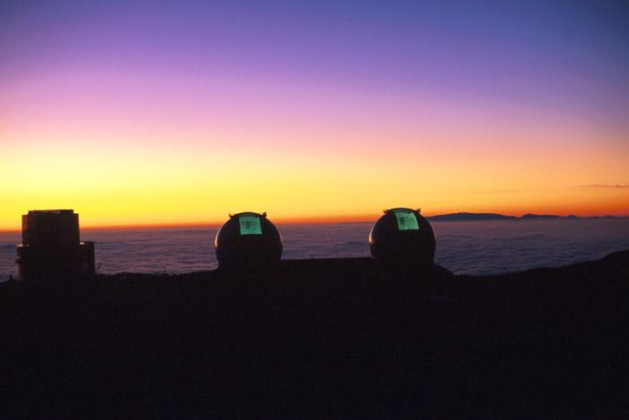
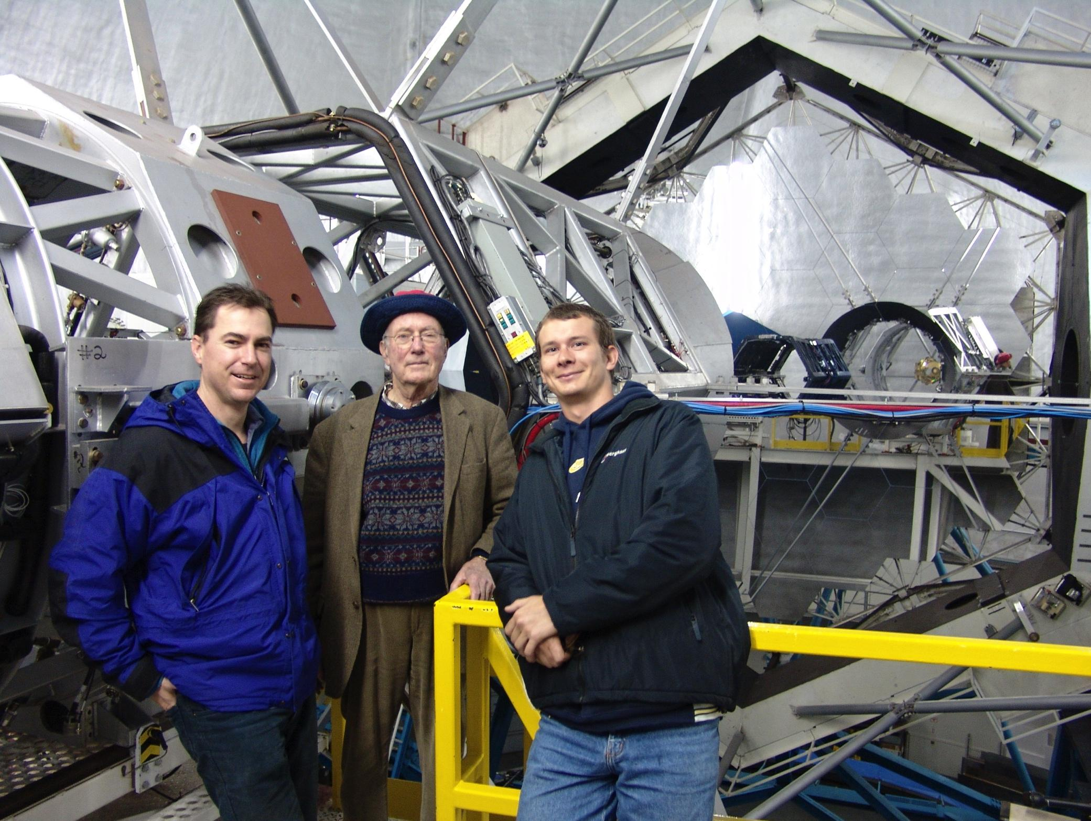
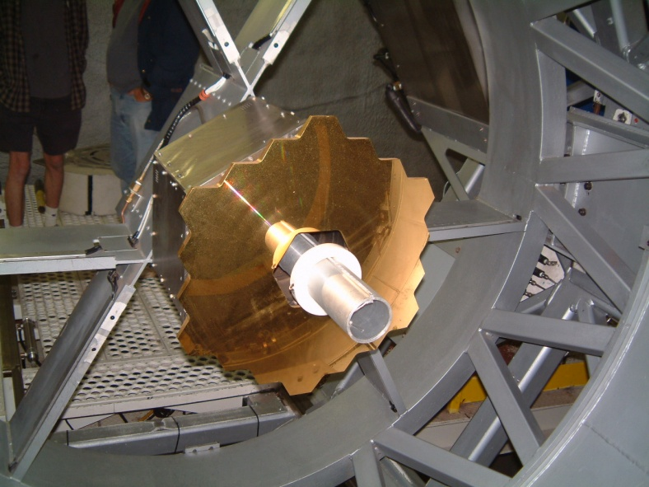
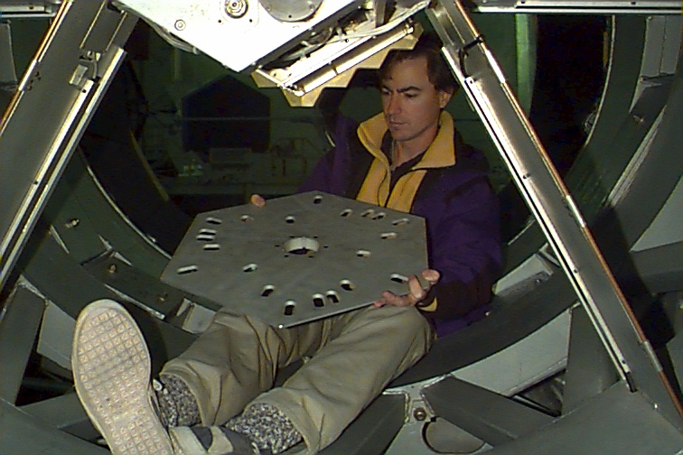
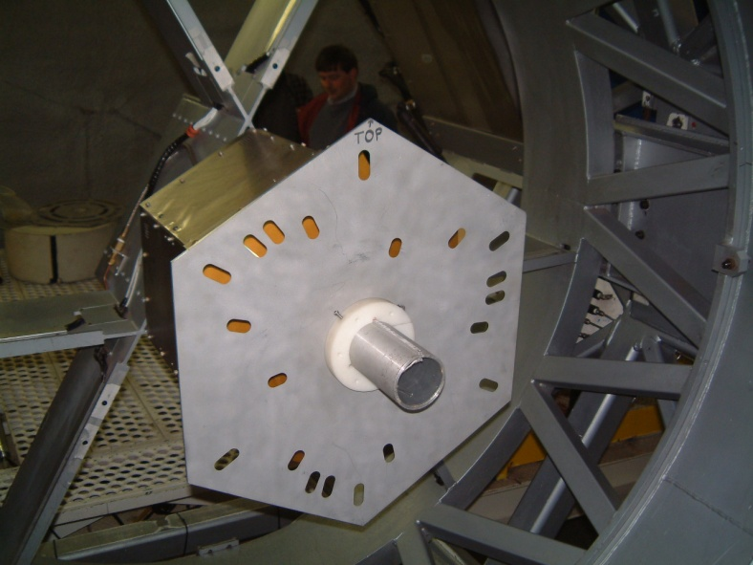
Notes:
reminiscing Andrew Berkeley … decided to zoom the lens back a little in this talk.
Trace the origins and thread of ideas as they evolve.

Slide 3
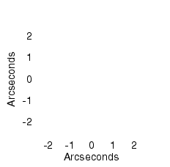
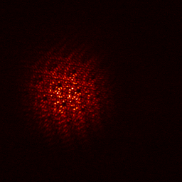
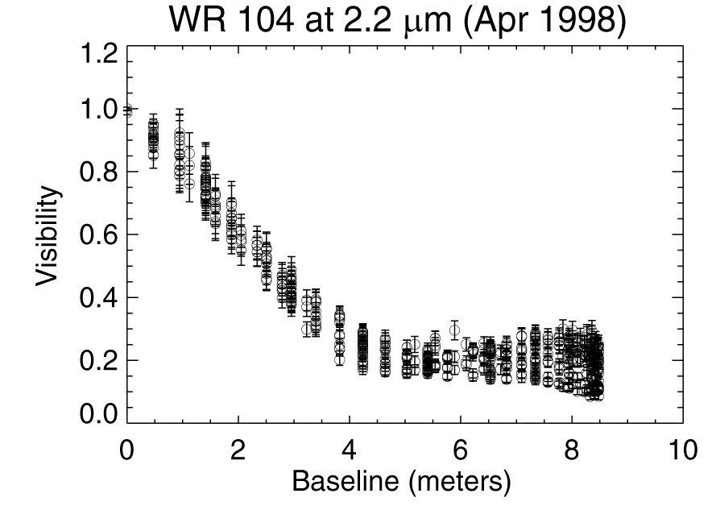
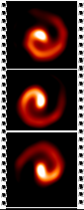
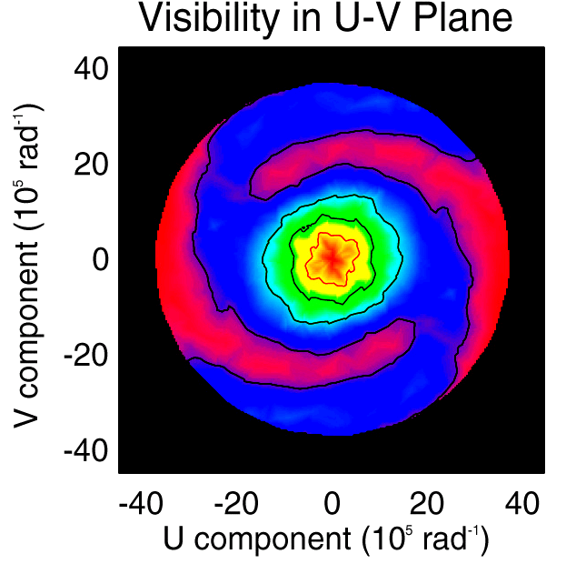
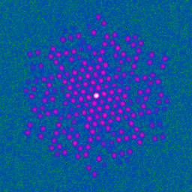
Long Baseline Interferometry within a single (large) mirror…
50 mas
April
June
June
FFT
September
Notes:
Remarkable thing was that for a $100 trashcan lid … I had the worlds’s best technology for imaging at the diffraction limit.
Why? Non-redundancy..

Slide 4
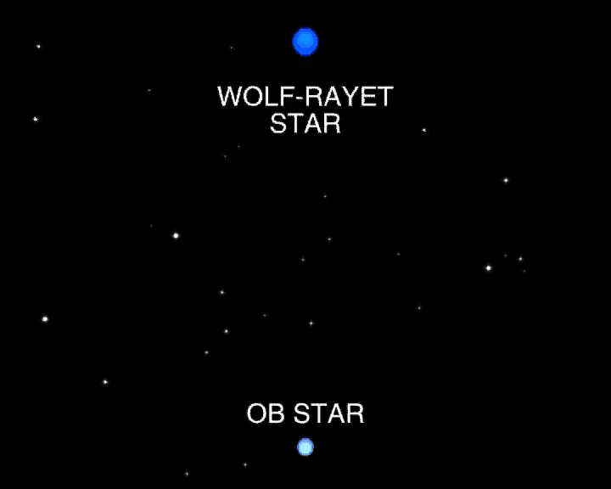
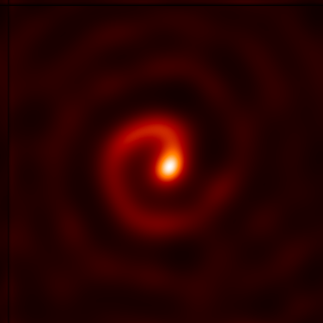
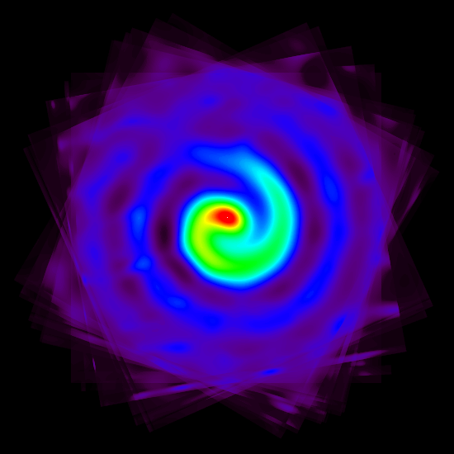
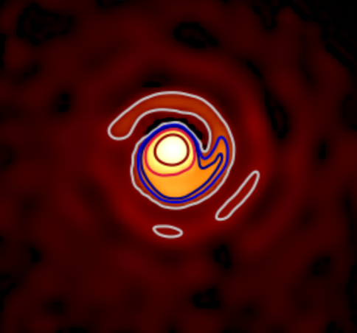
WR 104
11 epochs
K-band
Keck Masking
Stacked image
Keck Masking
17 years
WR 104
Adaptive Optics, SPHERE/ESO
Soulain et al A&A 2016
Tuthilll et al Nature 2001, 2008

Slide 5
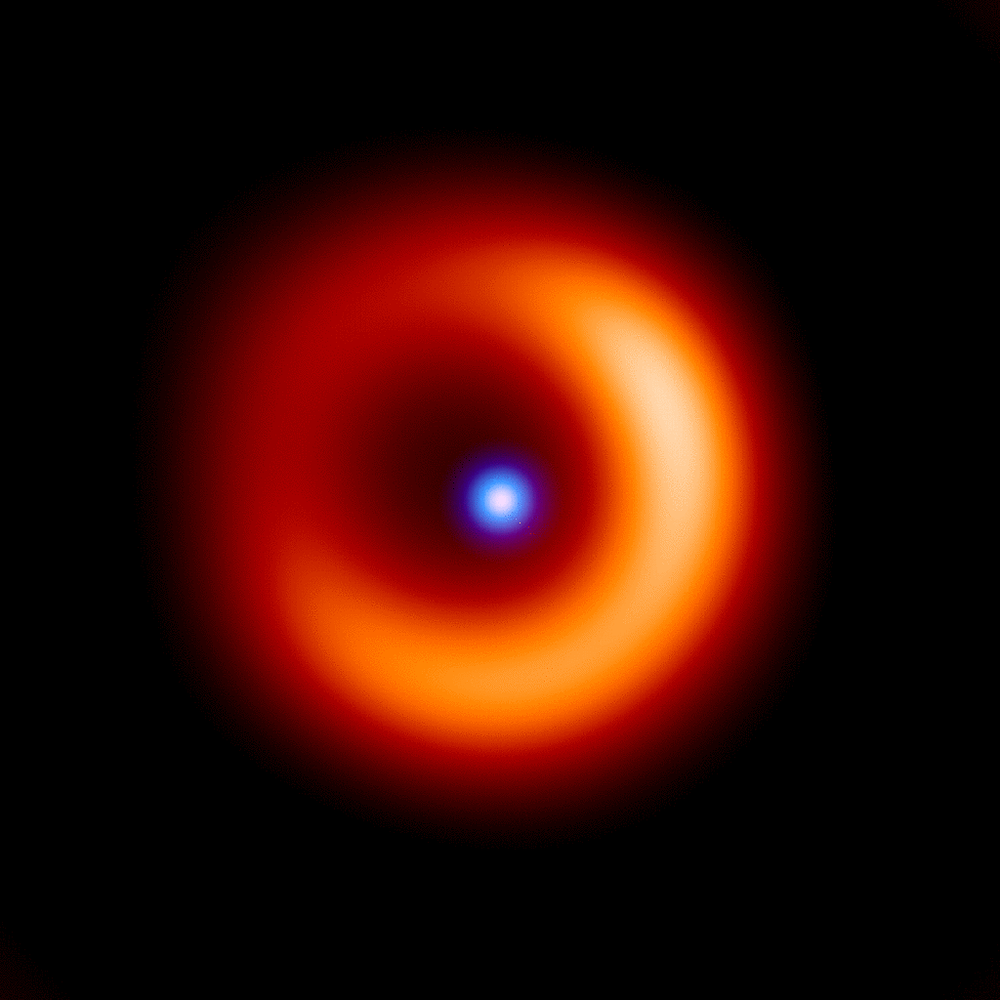
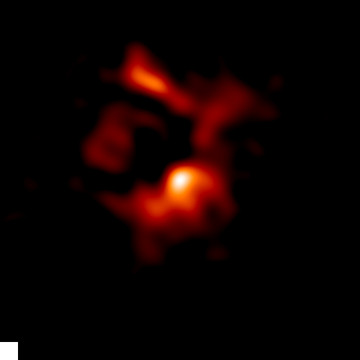
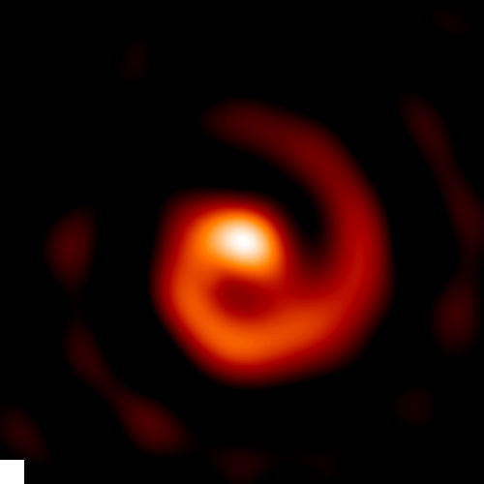
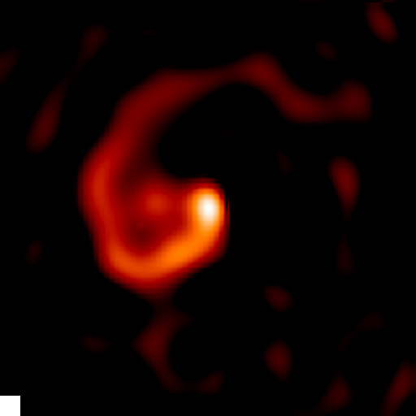
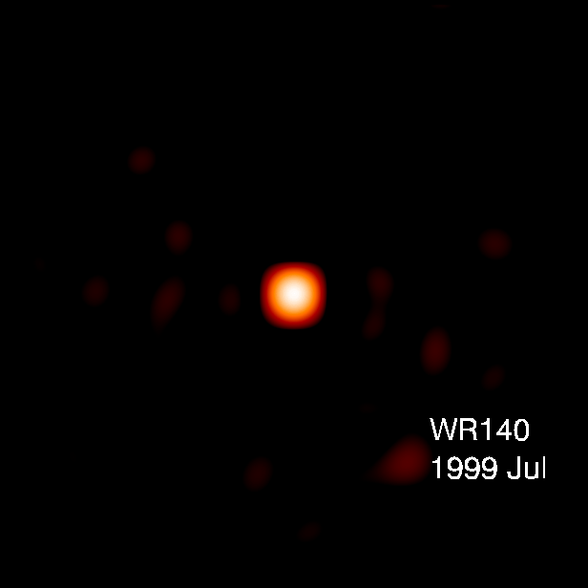
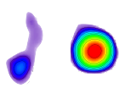
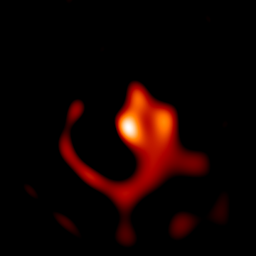
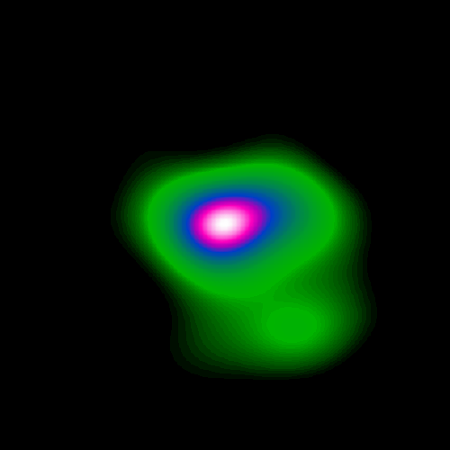
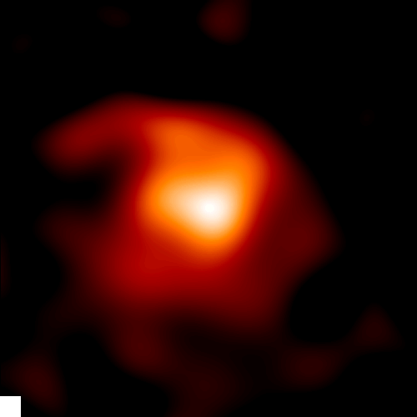
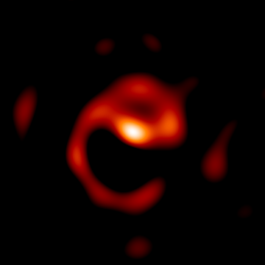
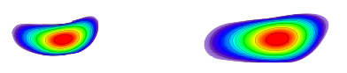
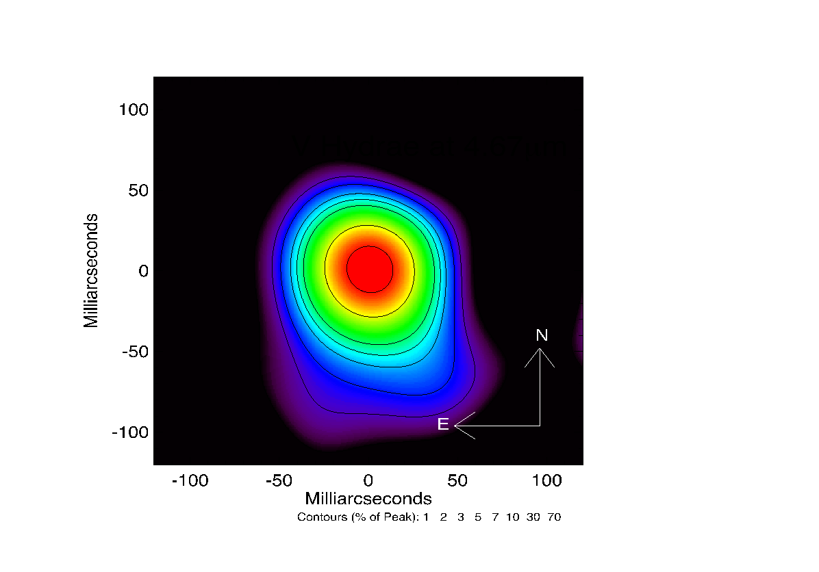
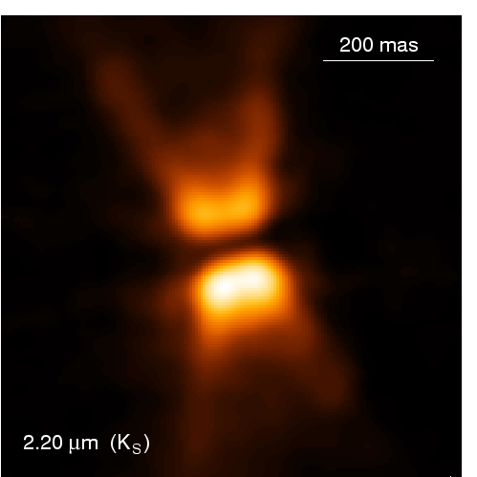
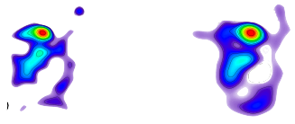
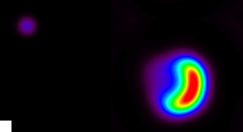
Lkha 101
IRC +10216
WR 104
WR 98a
WR 140
Mira A&B
WR 112
GCS4
GCS 3-2
CIT 6
MWC 349a
Red Rectangle
VY CMa
V Hya
LkHa 101
Notes:
So that dustbin lid on the last page must have been the best $300 dollars I ever spent.
On this page you can see the results of dozens of papers.
To date, there are 6 Nature/Science papers to come from this.
Outcomes span binaries, evolved stars, YSOs, & hot star mass loss.
A key point to make is that when we look at the universe at these scales, it becomes a dynamic place.
Everything is moving.

Slide 6
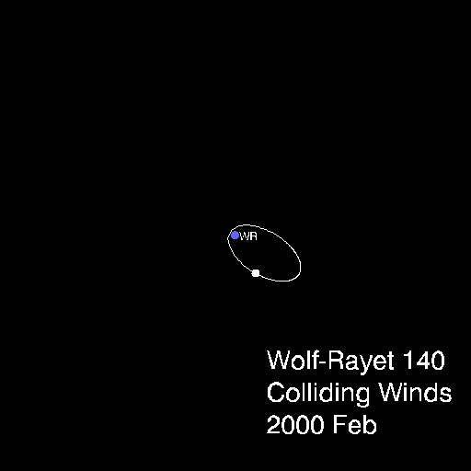
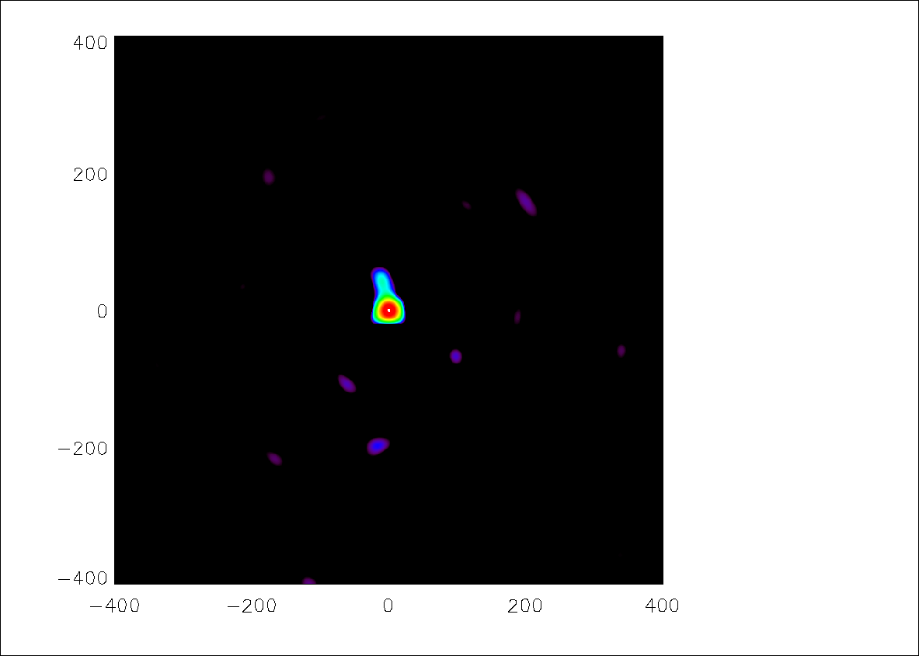
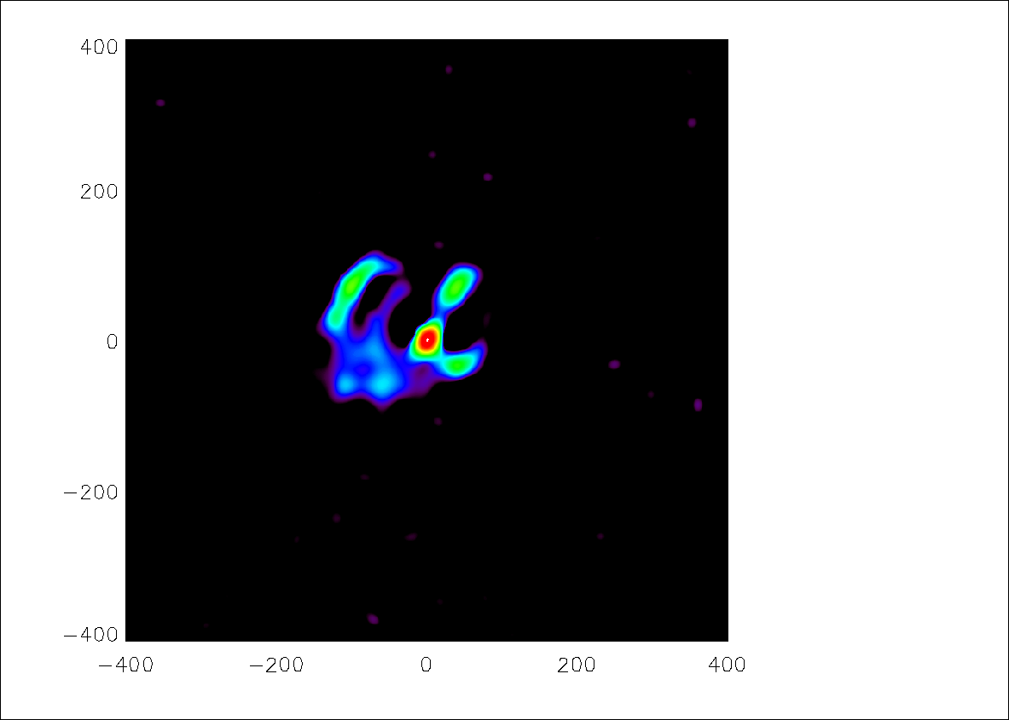
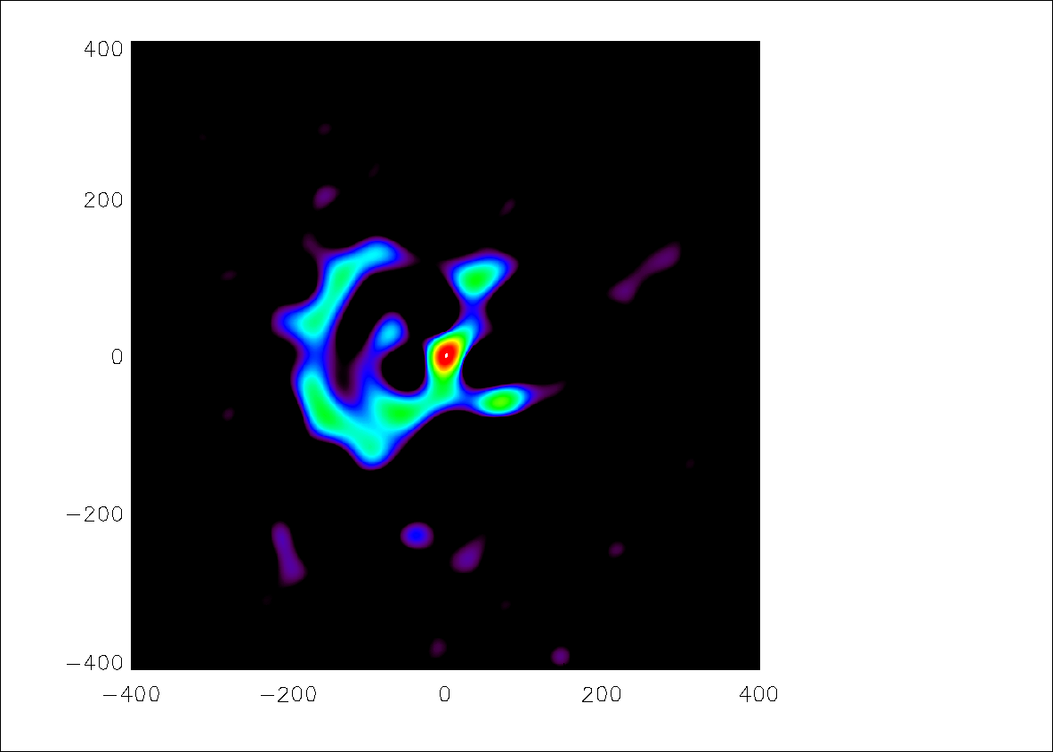
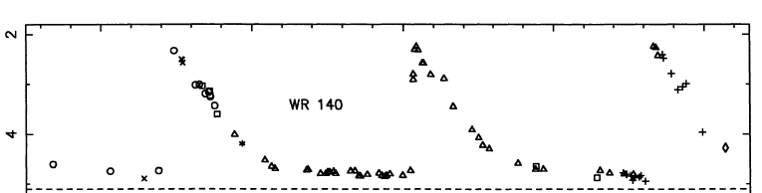
Jul99 K
Wolf-Rayet 140 (dusting for God’s thumbprint)
Jul99
Jun01
Jul01
8 years

Slide 7
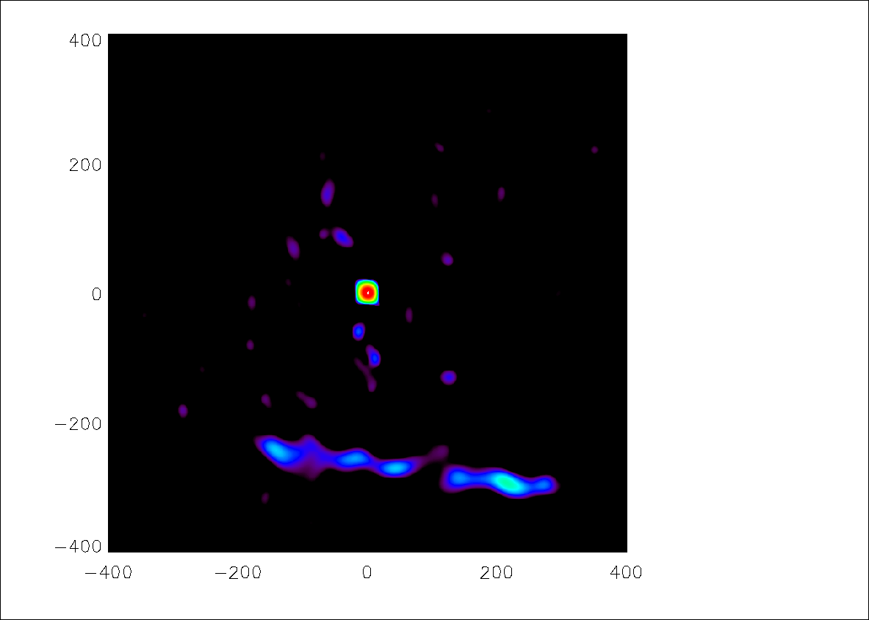
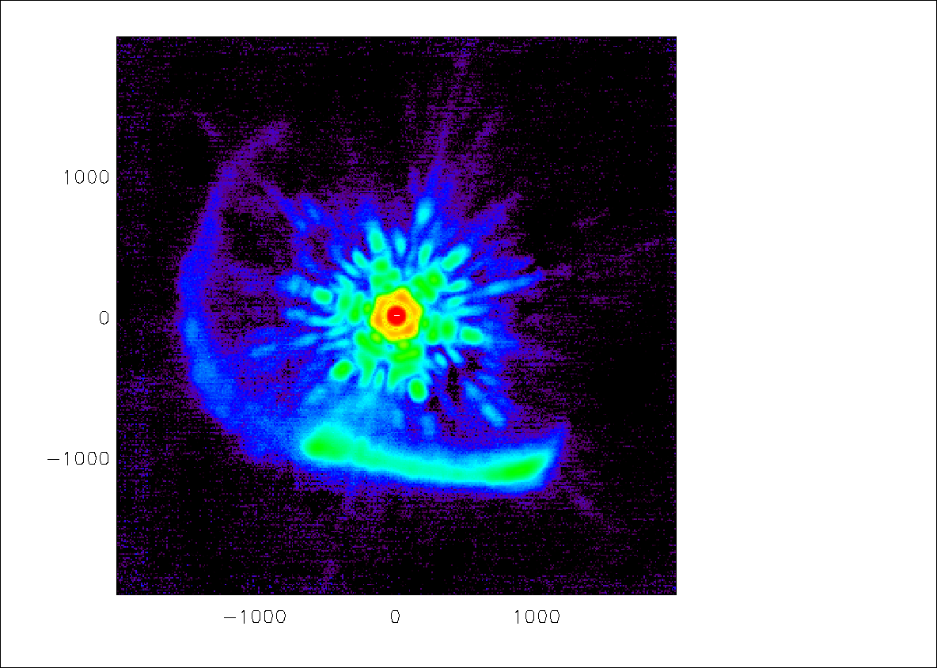
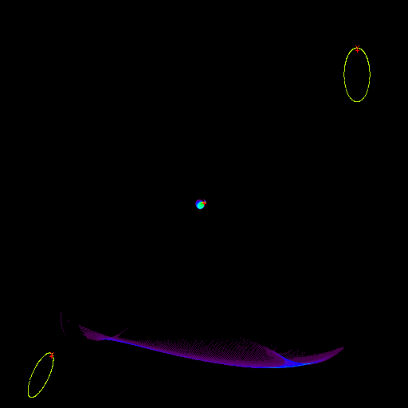
Wolf-Rayet 140 (dusting for God’s thumbprint)
Jul02
Oct05

Slide 8
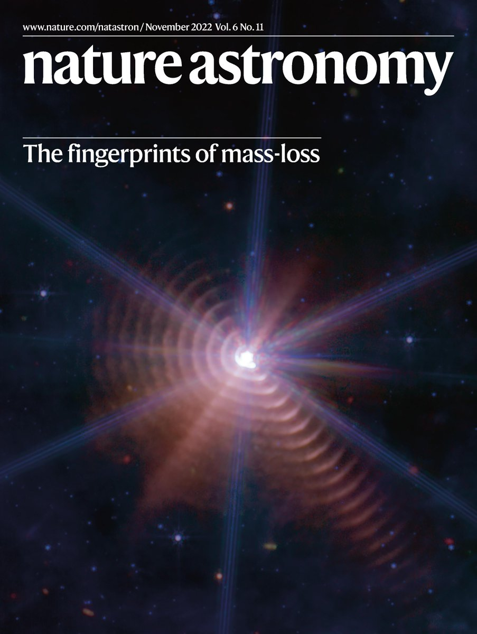
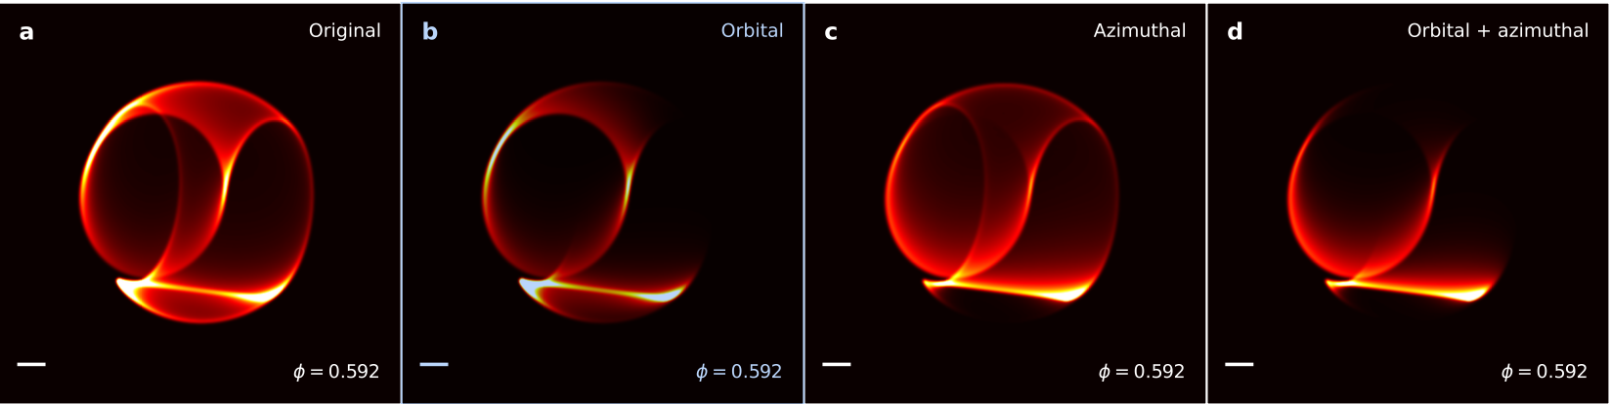
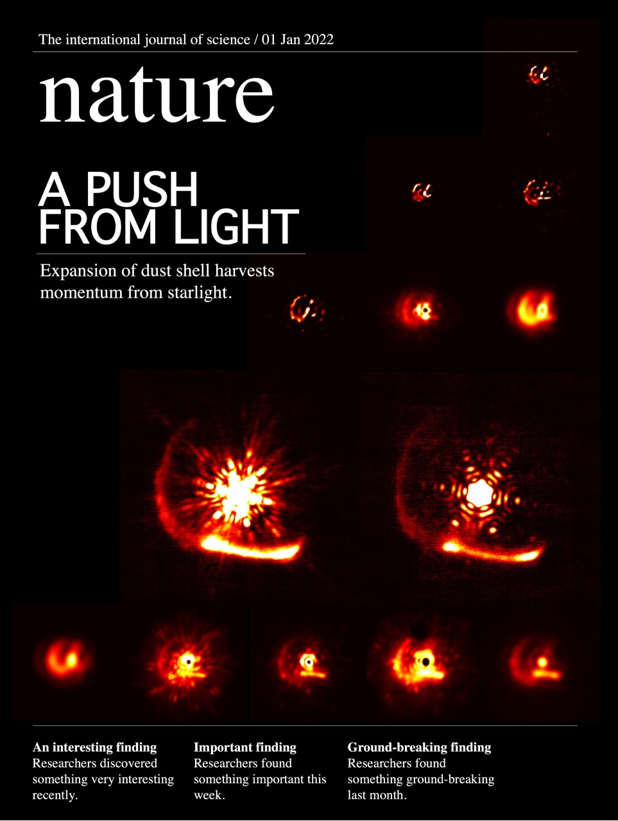
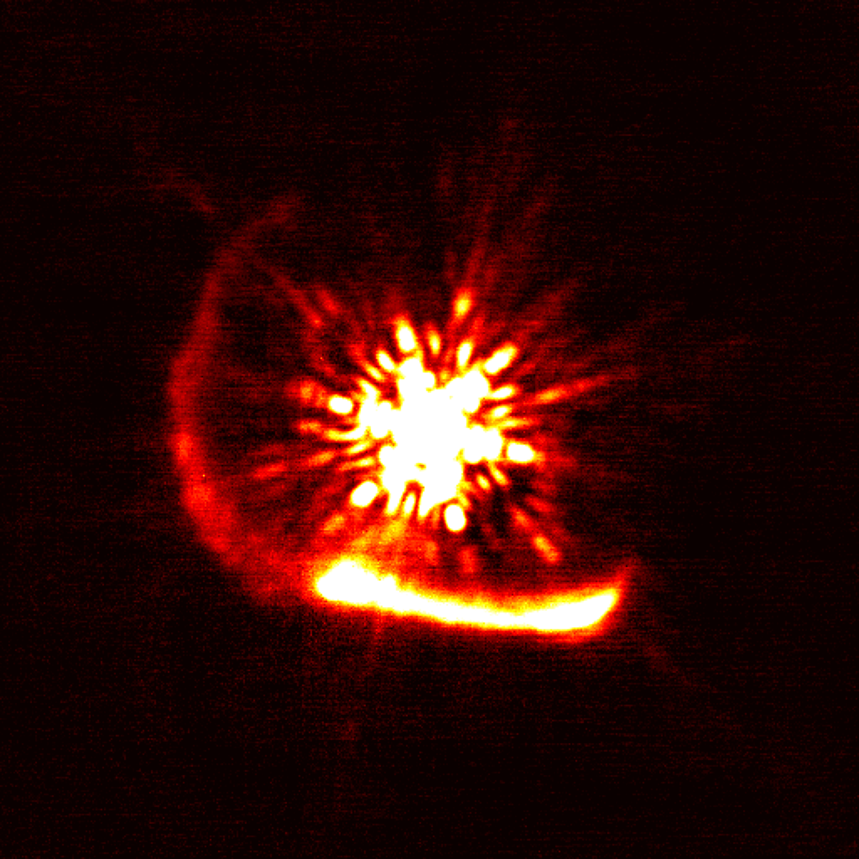
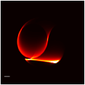
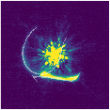
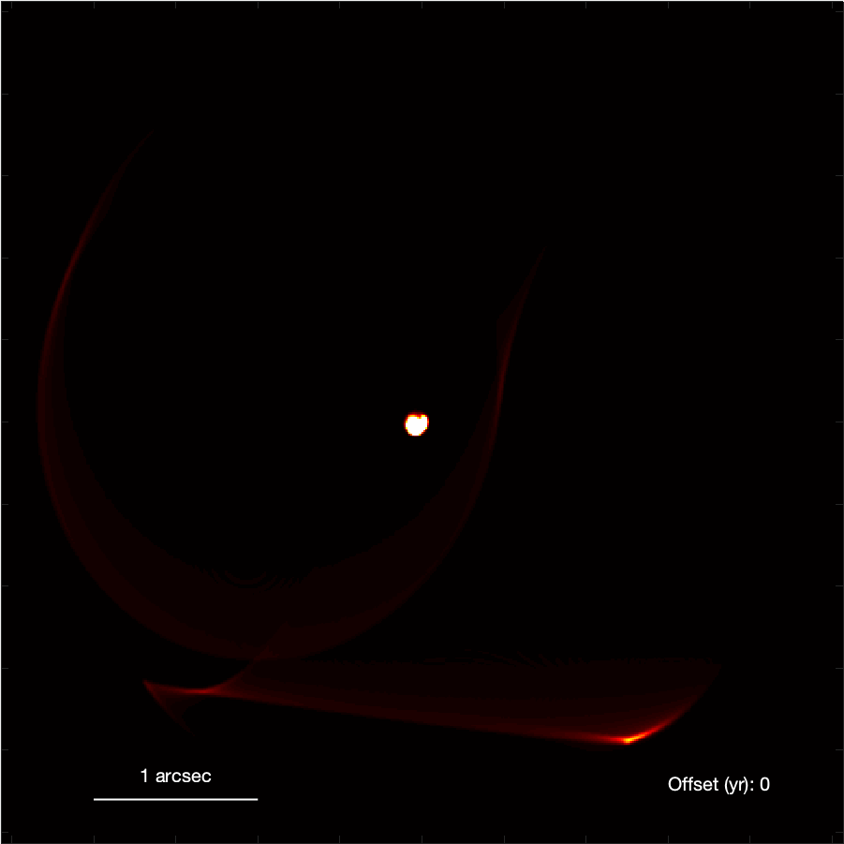
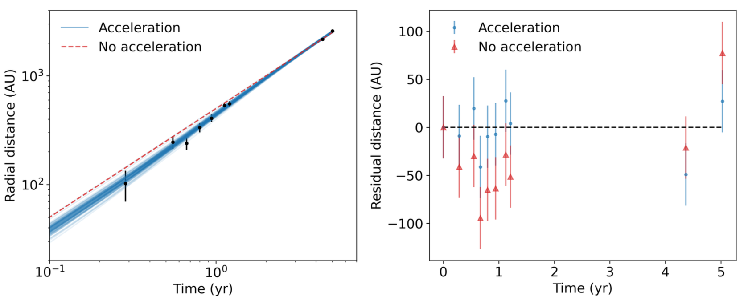
Wolf-Rayet 140 (dusting for God’s thumbprint)
Han, Tuthilll et al Nature 2022
Lau et al NatAst 2022

Slide 9
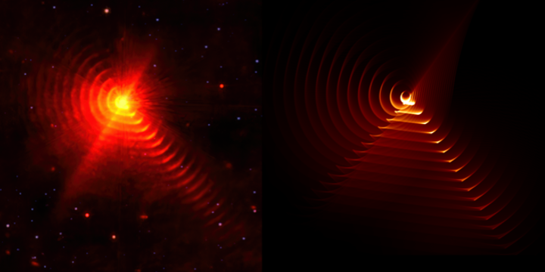
dust
~160yr of orbit-modulated dust
Image from MIRI
Model from Keck mask/AO

Slide 10
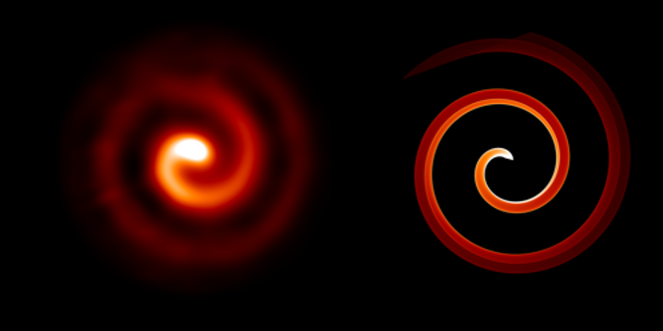
WR 104
Image: Peter Tuthill / Keck

Slide 11
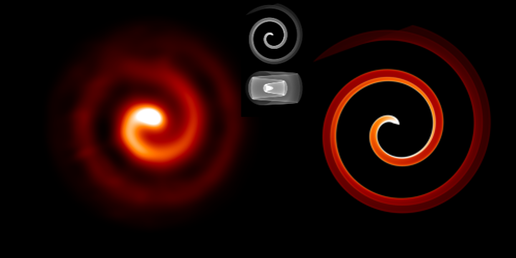
WR 104
Image: Peter Tuthill / Keck

Slide 12
WR 140
Image: Peter Tuthill / Yinuo Han / NASA

Slide 13

WR 140
Image: Peter Tuthill / Yinuo Han / NASA

Slide 14

WR112: many periods of continuous dust!
Lau et al. 2020

Slide 15



Visualisation: inclined
Visualisation: face-on
Evolution in time
Credit: Yinuo Han

Slide 16

Lau et al. 2020

Slide 17

WR 112
Image: Peter Tuthill / Yinuo Han / Ryan Lau

Slide 18

WR 112
Image: Peter Tuthill / Yinuo Han / Ryan Lau

Slide 19




WC + WN (Callingham et al. 2020)
Shock front imaged in radio (Marcote et al. 2021)
Binary detected in near-IR (Han et al. 2020)
2 arcsec
Mid IR
Near IR
Notes:
We went looking for it in the near-infrared, but didn’t find anything spectacular…until we had a look in the mid infrared.

Slide 20

Apep
Image: Peter Tuthill / Yinuo Han / ESO

Slide 21

Apep
Image: Peter Tuthill / Yinuo Han / ESO

Slide 22

Apep
Image: Peter Tuthill / ESO

Slide 23
The quest for coherence: astrophysical imaging from interferometry to photonics
Prof Peter Tuthill
University of Sydney
Image: Peter Tuthill / ESO

Slide 24
The quest for coherence:
astrophysical imaging from interferometry to photonics
Prof Peter Tuthill
University of Sydney
The Red Square
Peter Tuthill / Palomar and Keck Observatories

Slide 25


RED SQUARE - 3D STRUCTURE

Slide 26


